Slide 1

Senior Design Project
end-Term Presentation
Deep Learning for Detecting Distracted Drivers
Supervised By: Mr. Priyatosh Mishra
Group No.: U5
Ronik Kumar Das 2141004063
Saugat Mohanty 2141013224
Ankit Mishra 2141013145
Swoyam Prakash Mohanty 2141013226
Department of Computer Sc. and Engineering
Faculty of Engineering & Technology (ITER)
Siksha ‘O’ Anusandhan (Deemed to be) University
Bhubaneswar, Odisha
1

Slide 2
Presentation Outline
Introduction
Project Overview and problem Statement
Objectives & Motivations
Literature Review
Existing Solutions and Improvements Over Existing Solutions
Proposed Solution & Architecture
Schematic Layout
Key Components
Implementation Details
Algorithms & Tools Used
Results and Analysis
Test Results– Performance Metrics and System Outputs and Screenshots
Performance Comparison
Conclusion & Future Work
Key Finding
Scope for Improvement or Extension
Bibliography
2

Slide 3
Introduction
Project overview
Distracted driving is a significant issue worldwide, leading to numerous traffic accidents, injuries, and fatalities.
The increase in electronic device usage while driving, such as texting, making calls, and using in-car technologies, is a key factor.
Addressing the dangers of distracted driving requires urgent and proactive measures to improve road safety.
3

Slide 4
Introduction Contd…
Problem Statement
Functionality: Detects distractions such as texting, calling, eating, or reaching for objects using live video analysis.
Scope: Focused on visual-based detection, excluding biometric sensors or eye-tracking methods.
4

Slide 5
Introduction Contd…
Motivation
Enhancing road safety to reduce high traffic accident rates.
Law enforcement and awareness campaigns are not enough for continuous monitoring.
Deep learning with CNNs enables real-time distracted driver detection.
Provides real-time feedback to prevent accidents and save lives.
Widespread adoption could bring significant societal benefits
5

Slide 6
Introduction Contd…
Objectives & Expected Impact
Develop a deep learning model to classify driver behaviors and detect distractions.
Reduce accidents caused by distractions like texting, eating, or using a phone while driving.
Provide a tool that law enforcement and vehicle manufacturers can integrate into monitoring systems.
Create an open-source, accessible solution for further advancements in the field.
Contribute to research in computer vision and automated driver monitoring systems.
6

Slide 7
Literature Review
Existing Solutions
Table-1:Literature Survey of the Deep Learning for Detecting Distracted Drivers
Sl No. | Research Paper | Published By | Information Gain | Limitations
1 | Driver behavior detection and classification using deep convolutional neural networks. (2020) | Shahverdy, Mohammad & Fathy, Mahmood & Berangi, Reza & Sabokrou, Mohammad. | This paper presents a CNN-based method using vehicle signals and recurrence plots for accurate driver behavior detection. | Limited real-world generalization due to only three drivers and reliance on vehicle sensors for intent.
2 | Computer vision-based recognition of driver distraction: A review (2021) | Moslemi, Negar & Soryani, Mohsen & Azmi, Reza. | This review explores computer vision methods for recognizing manual driver distractions, datasets, challenges, and implementations. | Performance drops with occlusions, lighting changes; limited diverse datasets hinder generalization and consistent benchmarking.
3 | Distracted driver classification using deep learning (2020) | Alotaibi, Bandar & Alotaibi, Munif. | This study proposes a hybrid deep learning model to classify distracted driver behaviors from dashboard images. | Higher computation time than simpler models; performance relies on large, diverse training data availability.
7

Slide 8
Literature Review Contd…
Existing Solution
Table-1:Literature Survey of the Deep Learning for Detecting Distracted Drivers.(Contd..)
Sl No. | Research Paper | Citation | Information Gain | Limitations
4 | Automatic driver distraction detection using deep convolutional neural networks. (2022) | Hossain, Md & Rahman, Md & Islam, Manowarul & Akhter, Arnisha & Uddin, Md Ashraf & Paul, Bikash Kumar. | This paper uses transfer learning (VGG-16, ResNet50, MobileNetV2) for accurate, efficient distracted driver detection. | Real-time deployment and generalization unvalidated; performance may decline with limited or imbalanced data.
5 | Real-Time Distraction Detection Based on Driver's Visual Features. (2019) | Alam, Lamia & Hoque, Moshiul. | This paper achieves 92% accuracy detecting driver distraction in real-time using eye and head movement features. | Eye detection fails with sunglasses or poor lighting; small sample size limits generalizability to populations.
6 | Distracted Driver Detection: A Comparative Study Using CNN. (2022) | Jagadale, Sujay & Attar, Pirsab. | Presents CNN approach with custom and pre-trained models classifying distracted driving using real dashboard camera images. | Model accuracy drops with lighting or angle changes; continuous image monitoring raises privacy concerns.
8

Slide 9
Literature Review Contd…
Existing Solutions
Table-1: Literature Survey of the Deep Learning for Detecting Distracted Drivers (Contd..)
Sl No. | Research Paper | Citation | Information Gain | Limitations
7 | Enhancing Driver Safety with MobileNetV2-Based Transfer Learning for Drowsiness Detection. (2025) | Rajput, Ishwari & Tyagi, Sonam & Pandey, Vandana & Upreti, Abha & Kukreja, Jasleen. | This study uses transfer learning for real-time eye-based drowsiness detection, achieving 98.5% accuracy. | Accuracy drops with poor lighting or low camera quality; high processing power needed for real-time use.
8 | Smart Driver Assistance: Real-Time Drowsiness Detection Leveraging Facial Cues with MediaPipe and OpenCV. (2024) | Reddy, Ariveeti & Khan, Ibrahim & T, Neethu & Thampi, Lidiya & A, Aswathy & Kumar, Abhishek & Kumar, Sunny. | Presents real-time driver alert system using facial cues and CNN, combining computer vision for accurate detection. | CNNs perform poorly in low light and varied conditions; Dlib is unstable for head tracking.
9 | Enhancing Road Safety: Real-Time Detection of Driver Distraction through Convolutional Neural Networks. (2024) | Sheikh, Amaan & Khan, Imaad. | This study compares CNN and hybrid CNN-Transformer architectures for real-time driver distraction detection, achieving 98% accuracy using fine-tuned deep learning models. | High-performing models require powerful hardware, limiting deployment; deeper models slow processing, reducing real-time responsiveness.
9

Slide 10
Literature Review Contd…
Improvements Over Existing Solutions
Automated Data Handling – Faster dataset retrieval & processing.
Optimized Training – Efficient hyperparameters & visualization tools.
Performance Boost – Faster training with better preprocessing.
Higher Accuracy – Advanced augmentation & potential ensemble models.
10

Slide 11
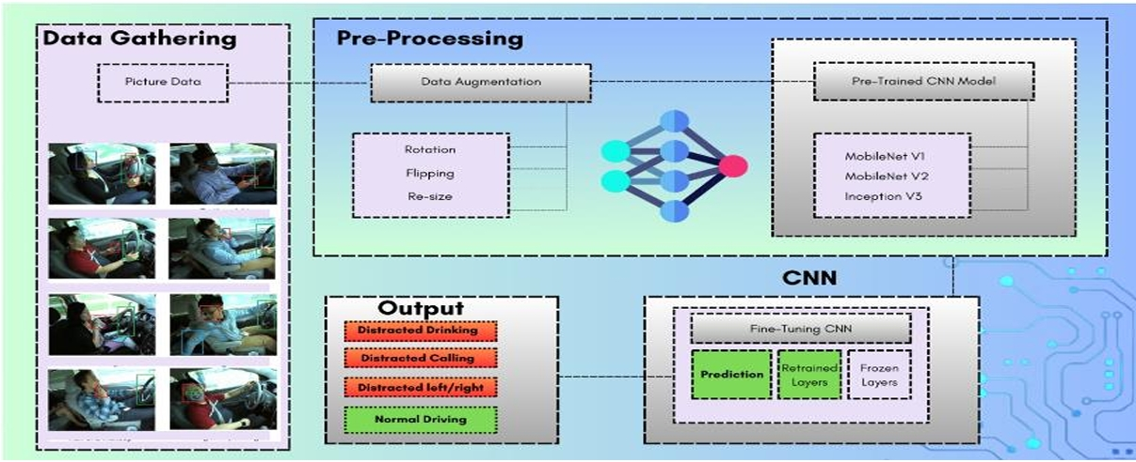
Proposed Solution & Architecture
Schematic Layout
Fig 1: Schematic Layout of our Model
11

Slide 12
Proposed Solution & Architecture Contd…
Key Components
Dataset Handling – Automated downloading & extraction via Kaggle API.
Preprocessing – Data cleaning, resizing (224×224), normalization, and batch-wise loading.
Model Training – Transfer learning using MobileNetV2 with optimized parameters with hyperparameter tuning and K-Fold validation.
Performance Optimization – Memory-efficient generators, small batch sizes, and early stopping.
UI Deployment – Tkinter-based real-time alert system (winSound) with OpenCV and model integration.
12

Slide 13
Proposed Solution & Architecture Contd…
Key Components – MobileNet V2
MobileNetV2 is a lightweight convolutional neural network architecture designed for embedded devices or Mobile devices .
The MobileNetV2 has higher Accuracy (94.55%) Than Hyperparameter-Tuned Model (84.05%):Compact Architecture: MobileNetV2 trades accuracy for speed and size.Limited Capacity
Hyperparameter Tuning: Custom models benefit from optimized learning rate, layers, dropout, etc., improving performance.
So, while MobileNetV2 is optimized for speed and resource efficiency, a well-tuned model usually performs better in terms of accuracy.
13

Slide 14
Implementation Details
Algorithms and Tools Used
Convolutional Neural Network (CNN) model for real-time image classification.
ReLU activation function in convolutional layers, followed by softmax in the fully connected layer for output probabilities.
Optimization: Backpropagation, transfer learning, and hyperparameter tuning for improved accuracy.
Cross-validation: K-fold cross-validation to evaluate model performance.
Computer Vision (OpenCV)Captures real-time video feed and preprocesses frames for model input.
14

Slide 15
Implementation Details
Algorithms and Tools Used
Custom CNN (From Scratch)Conv2D → ReLU → MaxPooling (x3): Extracts features from the image—edges, shapes, patterns—while reducing size.
Flatten: Converts the 2D feature maps to a 1D vector.
Dense layer + Dropout(0.5): Learns complex relationships, Dropout prevents overfitting.
Dense(10, softmax): Outputs probabilities for 10 driver classes.
Simple, good for learning and good accuracy.
15

Slide 16
Implementation Details
Tools Used
Google Colab – Interactive cloud environment for writing and executing Python code.
Libraries – Pandas, NumPy, TensorFlow, Keras, OpenCV, Matplotlib, and Scikit-learn for data handling, modeling, visualization, and evaluation, Shutil.
16

Slide 17
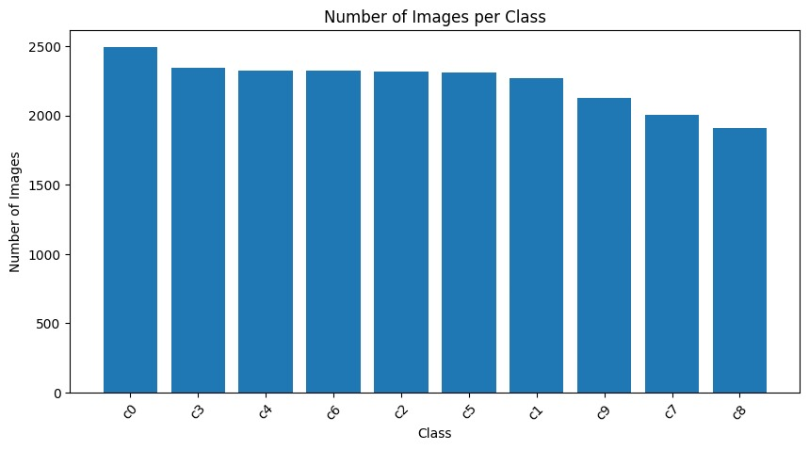
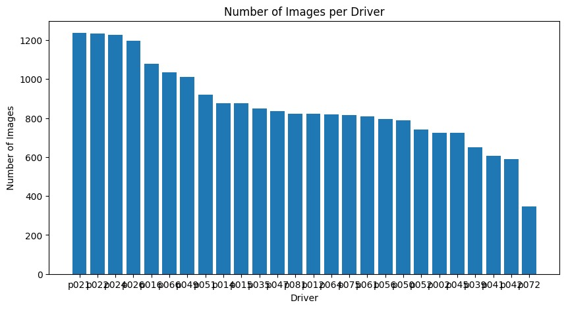
Results and Analysis
Test Results – Graphs of Images per class and Drivers.
Fig 1 : Number Of images Fig 2 : Number Of Images per Drivers
17

Slide 18
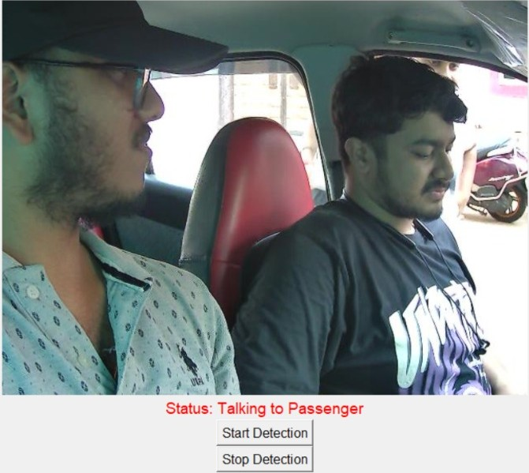
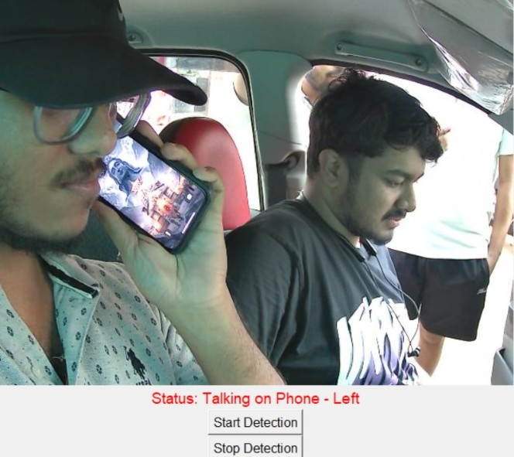
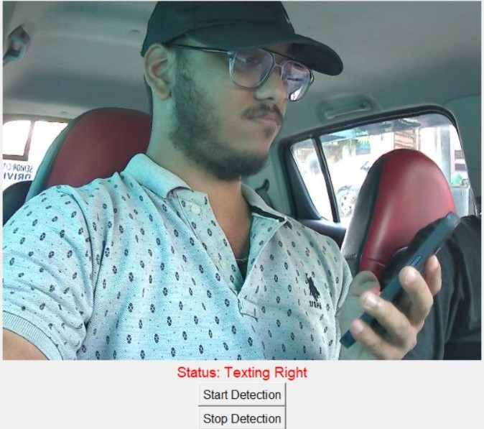
Results and Analysis Contd…
Test Results- Real time Detections
Fig 3 : Talking to passenger Fig 4: Talking on phone – left Fig 5: texting Right
18

Slide 19
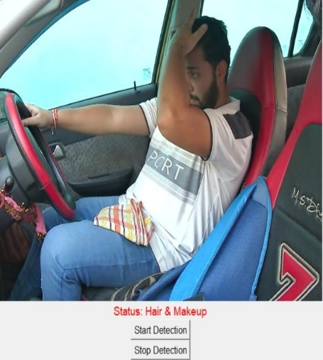
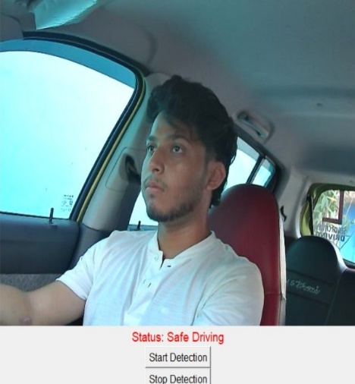
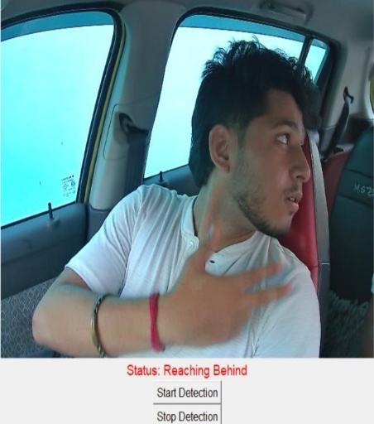
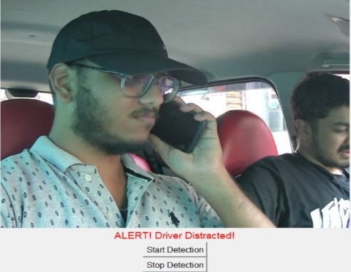
Results and Analysis
Test Results- Real time Detections
Fig 6: Hair & makeup Fig 7: Safe Driving Fig 8: Reaching Behind Fig 9: Driver Distracted
19

Slide 20
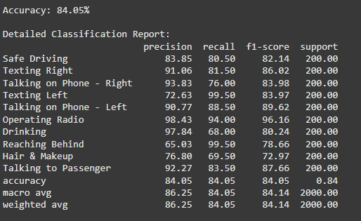
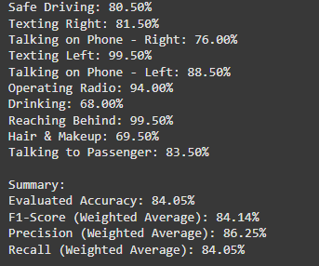
Results and Analysis
Test Result – Model with Hyperparameter Tuning
Fig 10: Classification of Model Fig 11: Summary values obtained
20

Slide 21
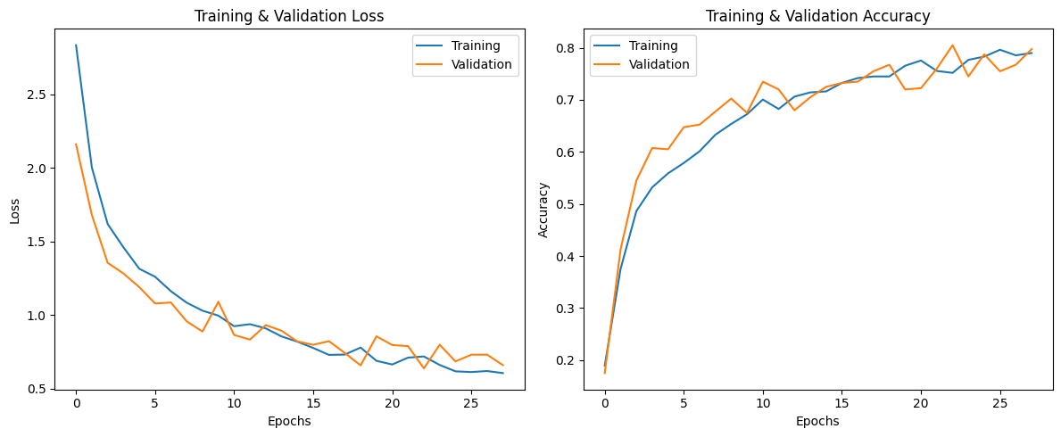
Results and Analysis Contd…
Test Results – Evaluating the model with hyperparameter tuning.
Fig 12 : Training & Validation Loss Fig 13: Training & validation Accuracy
21

Slide 22
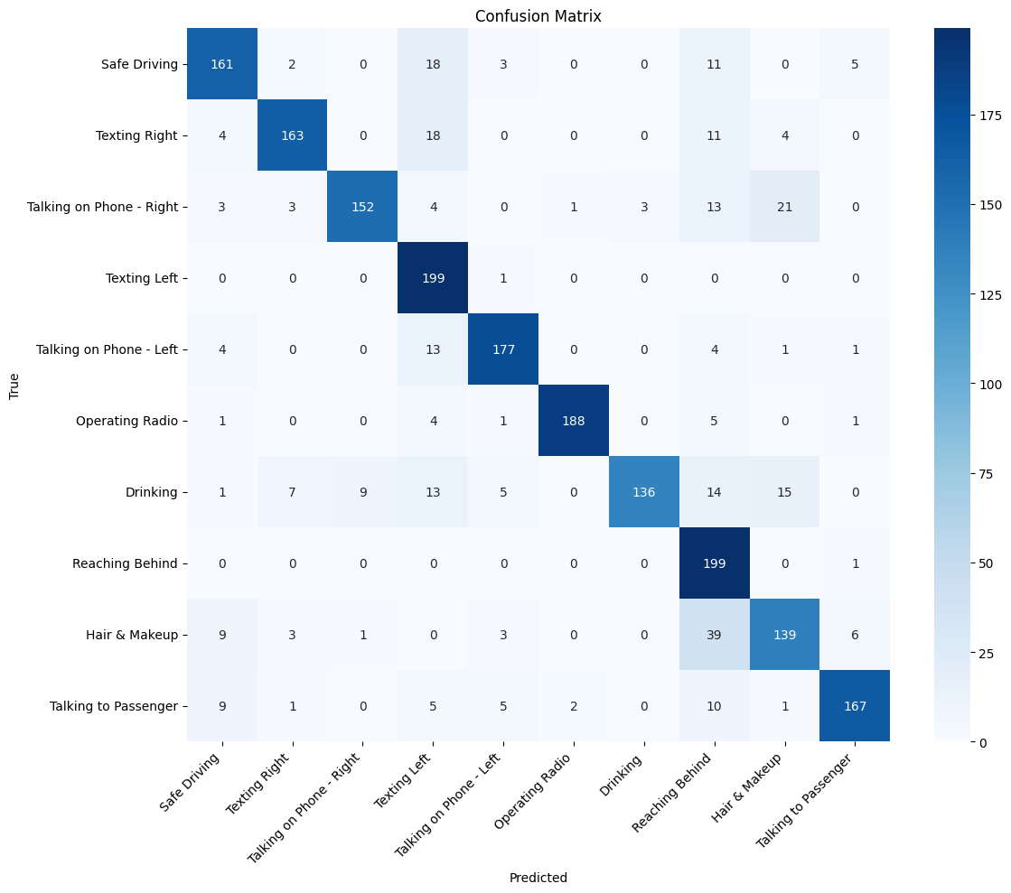
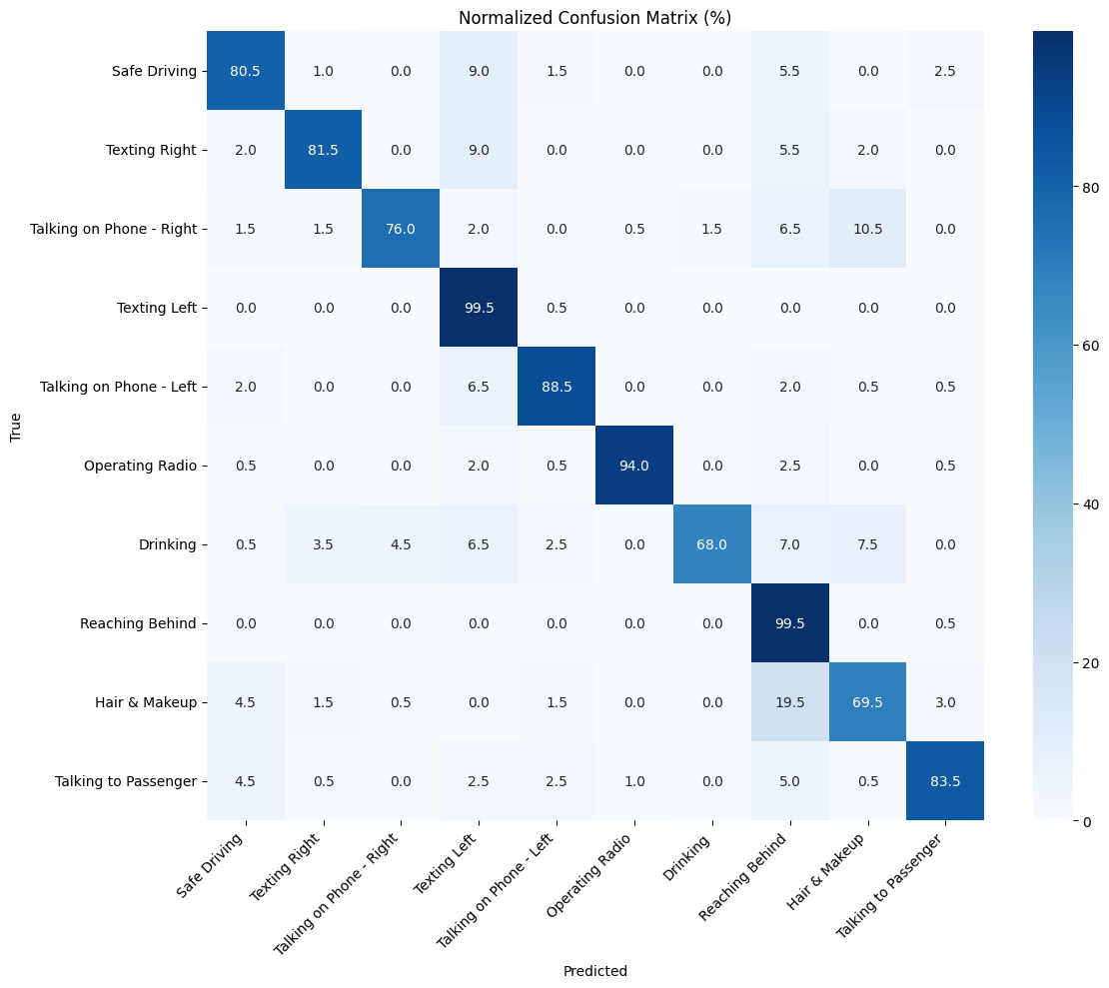
Results and Analysis Contd…
Test Results – Confusion matrix for model with hyperparameter tuning
Fig 14: Confusion Matrix Fig 15: Normalized Confusion Matrix
22

Slide 23
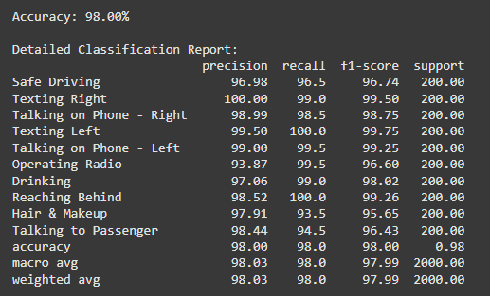
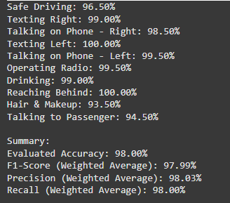
Results and Analysis Contd…
Test Results – Fine-Tuned Model
Fig 16: Classification of Model Fig 17: Summary values obtained
23

Slide 24
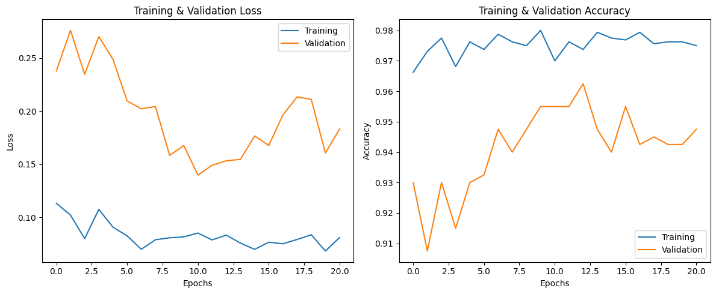
Results and Analysis Contd…
Test Results – Evaluating Fine-Tuned Model
Fig 18: Training and validaton loss Fig 19: Training and validation accuracy
24

Slide 25
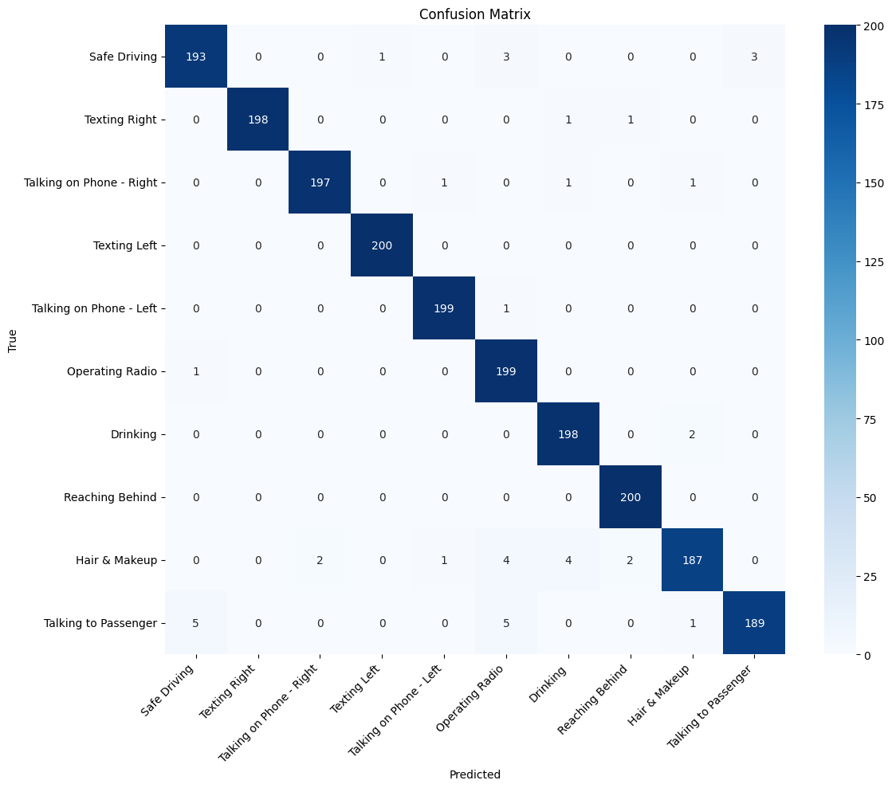

Results and Analysis Contd…
Test Results – Confusion matrix for Fine-Tuned Model
Fig 20: Confusion Matrix Fig 21 : Normalized Confusion Matrix
25

Slide 26
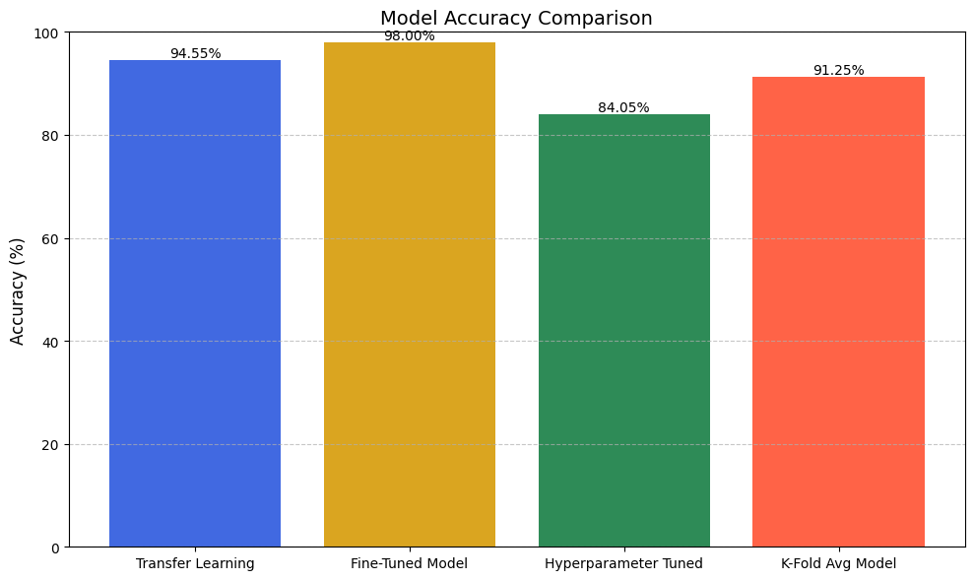
Results and Analysis Contd…
Test Results – Comparison of all Model Accuracy
Fig 22: Accuracy of Models
26

Slide 27
Conclusion and Future Work
Developing a real-time distracted driver detection system using deep learning and computer vision to enhance road safety.
Addressing the growing risks of distracted driving by providing an automated and accurate detection system.
Convolutional Neural Networks (CNNs), TensorFlow/Keras, OpenCV, and State Farm Distracted Driver Detection dataset for training.
Scope for Improvement
Grad Cam++ can be implemented for heat mapping areas.
MultiCam functionalty can be implemented.
Can be integrated into smart vehicles and driver assistance systems for proactive safety measures.
27

Slide 28
Bibliography
Shahverdy, Mohammad & Fathy, Mahmood & Berangi, Reza & Sabokrou, Mohammad. (2020). Driver Behavior Detection and Classification Using Deep Convolutional Neural Networks. Expert Systems with Applications. 149. 113240. 10.1016/j.eswa.2020.113240.
Moslemi, Negar & Soryani, Mohsen & Azmi, Reza. (2021). Computer vision-based recognition of driver distraction: A review. Concurrency and Computation Practice and Experience. 33. 10.1002/cpe.6475.
Alotaibi, Bandar & Alotaibi, Munif. (2020). Distracted Driver Classification Using Deep Learning. Signal Image and Video Processing. 14. 10.1007/s11760-019-01589-z.
Hossain, Md & Rahman, Md & Islam, Manowarul & Akhter, Arnisha & Uddin, Md Ashraf & Paul, Bikash Kumar. (2022). Automatic Driver Distraction Detection using Deep Convolutional Neural Networks. Intelligent Systems with Applications. 14. 200075. 10.1016/j.iswa.2022.200075.
28

Slide 29
Bibliography Contd…
Alam, Lamia & Hoque, Moshiul. (2019). Real-Time Distraction Detection Based on Driver's Visual Features. 1-6. 10.1109/ECACE.2019.8679191.
Jagadale, Sujay & Attar, Pirsab. (2022). Distracted Driver Detection: A Comparative Study Using CNN. 2449-2458. 10.46254/IN02.20220579.
Rajput, Ishwari & Tyagi, Sonam & Pandey, Vandana & Upreti, Abha & Kukreja, Jasleen. (2025). Enhancing Driver Safety with MobileNetV2-Based Transfer Learning for Drowsiness Detection. Procedia Computer Science. 259. 1239-1248. 10.1016/j.procs.2025.04.079.
Reddy, Ariveeti & Khan, Ibrahim & T, Neethu & Thampi, Lidiya & A, Aswathy & Kumar, Abhishek & Kumar, Sunny. (2024). Smart Driver Assistance: Real-Time Drowsiness Detection Leveraging Facial Cues with MediaPipe and OpenCV. 10.21203/rs.3.rs-4642662/v1.
Sheikh, Amaan & Khan, Imaad. (2024). Enhancing Road Safety: Real-Time Detection of Driver Distraction through Convolutional Neural Networks. 10.48550/arXiv.2405.17788.
29

Slide 30

30

